Slide 1
Multimodal Embeddings
Yanyu XU
2020-02-28

Slide 2
Outlines
Language2Pose
Unpaired Image-to-Speech Synthesis
Unsupervised Image Captioning

Slide 3
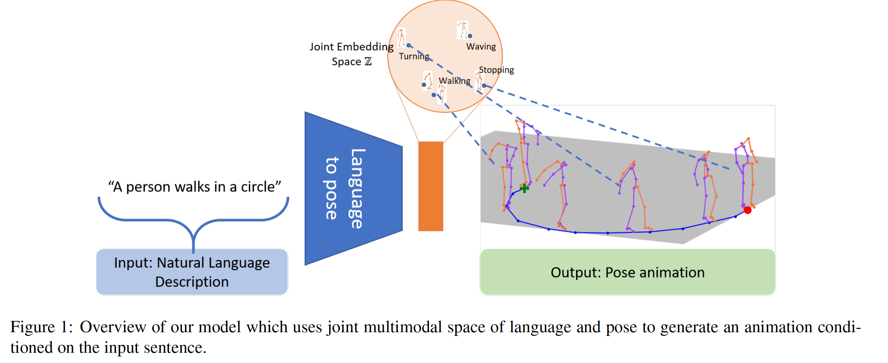
Language2Pose
Generating animations from natural language sentences
Ahuja C, Morency L P. Language2Pose: Natural Language Grounded Pose Forecasting[C]//2019 International Conference on 3D Vision (3DV). IEEE, 2019: 719-728.
Notes:
As an example, consider a natural language sentence which describes a human’s motion: ”A person walks in a circle”. The goal of this cross-modal language-to-pose translation task is to generate an animation representing the sentence; i.e. an animation that shows a person following a trajectory of a circle with a walking motion (see figure 1).

Slide 4
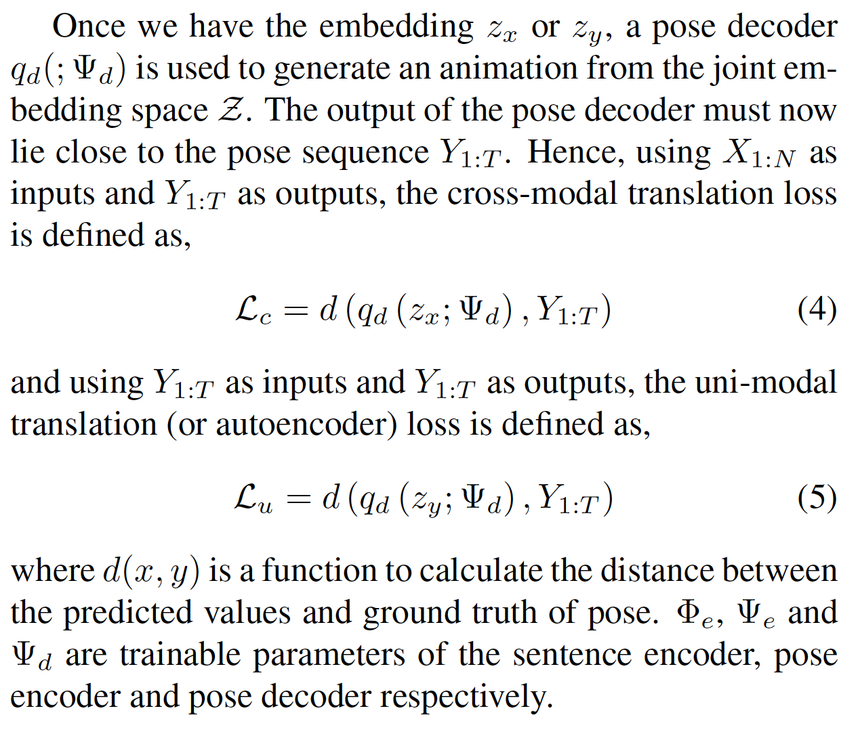
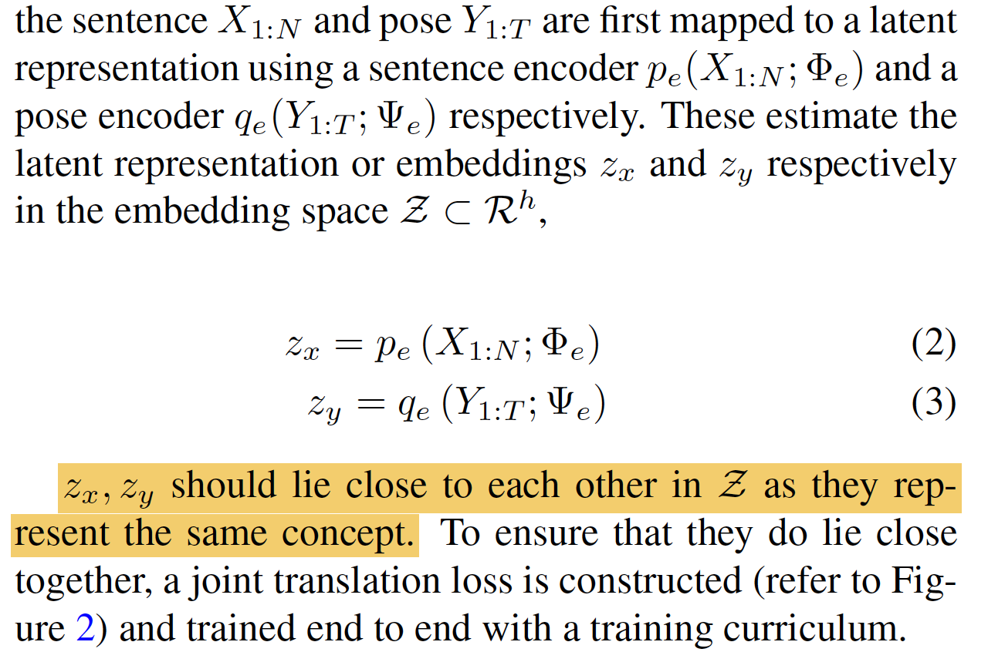
Joint Language-to-Pose
Joint Embedding Space for Language and Pose
Joint Loss Function
Ahuja C, Morency L P. Language2Pose: Natural Language Grounded Pose Forecasting[C]//2019 International Conference on 3D Vision (3DV). IEEE, 2019: 719-728.

Slide 5
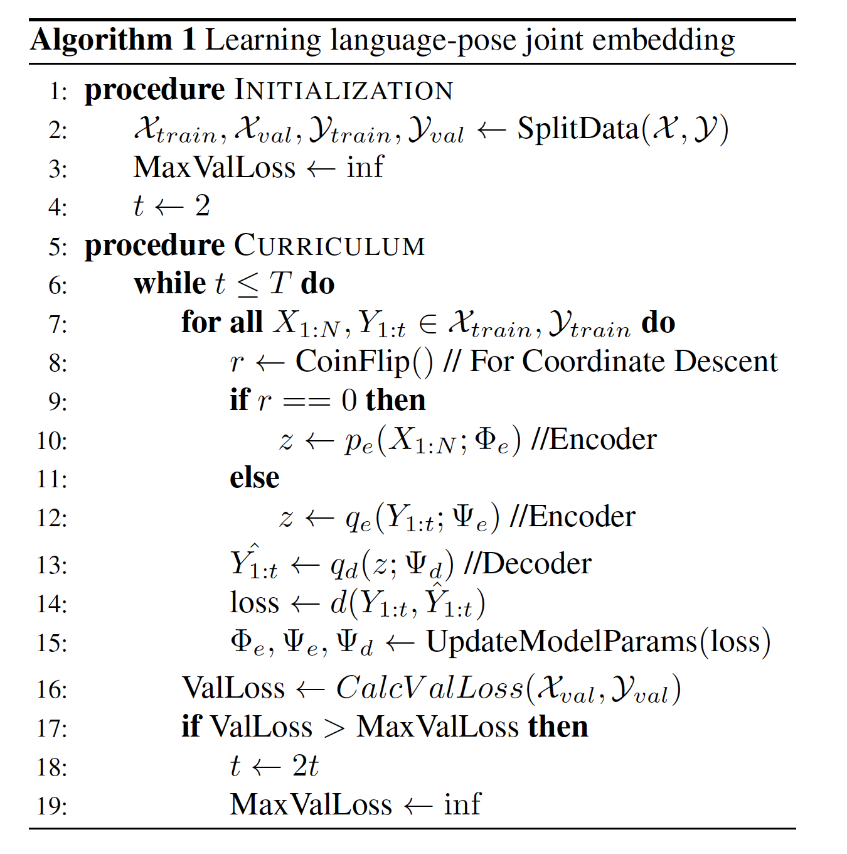
Joint Language-to-Pose
Training Curriculum
Ahuja C, Morency L P. Language2Pose: Natural Language Grounded Pose Forecasting[C]//2019 International Conference on 3D Vision (3DV). IEEE, 2019: 719-728.

Slide 6
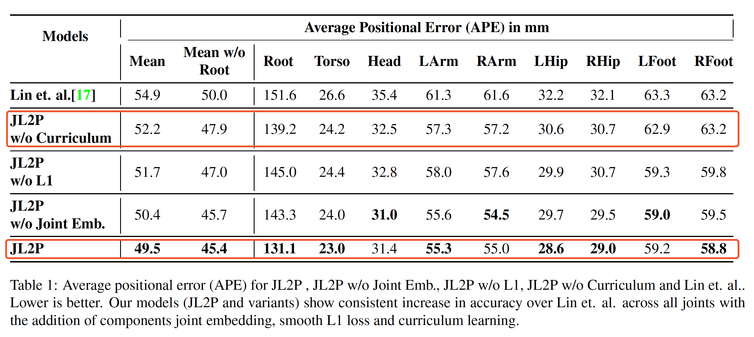
Experiments
Ahuja C, Morency L P. Language2Pose: Natural Language Grounded Pose Forecasting[C]//2019 International Conference on 3D Vision (3DV). IEEE, 2019: 719-728.

Slide 7
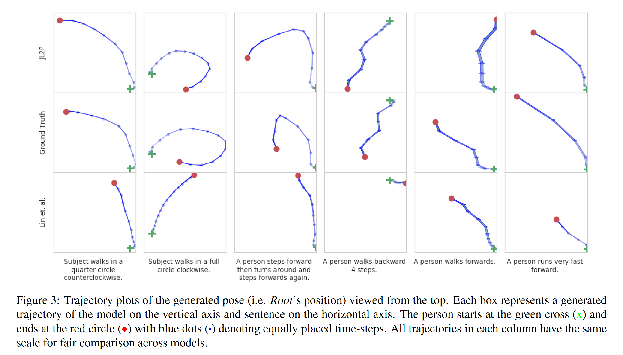
Experiments
Ahuja C, Morency L P. Language2Pose: Natural Language Grounded Pose Forecasting[C]//2019 International Conference on 3D Vision (3DV). IEEE, 2019: 719-728.

Slide 8
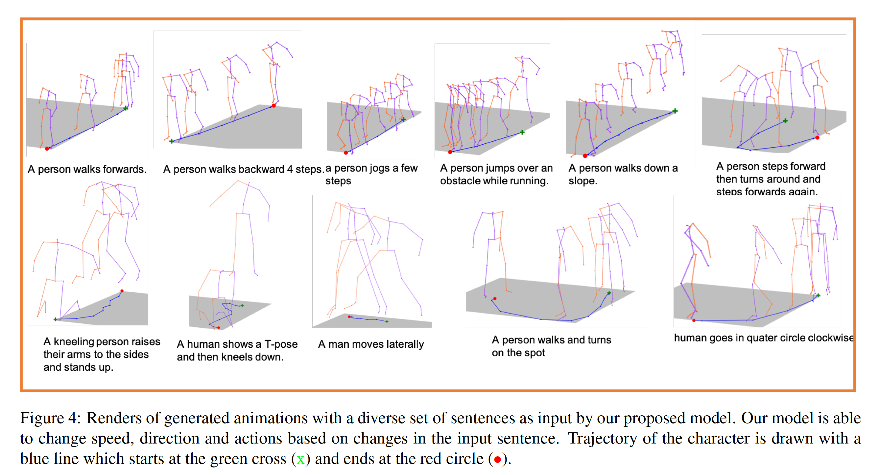
Experiments
Ahuja C, Morency L P. Language2Pose: Natural Language Grounded Pose Forecasting[C]//2019 International Conference on 3D Vision (3DV). IEEE, 2019: 719-728.

Slide 9
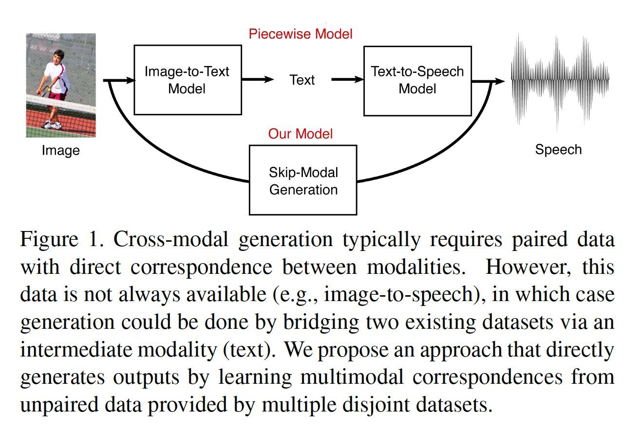
Unpaired Image-to-Speech Synthesis
We introduce the novel problem of translating instances from one modality to another without paired data by leveraging an intermediate modality shared by the two other modalities.
Ma S, McDuff D, Song Y. Unpaired Image-to-Speech Synthesis with Multimodal Information Bottleneck[C]//Proceedings of the IEEE International Conference on Computer Vision. 2019: 7598-7607.

Slide 10
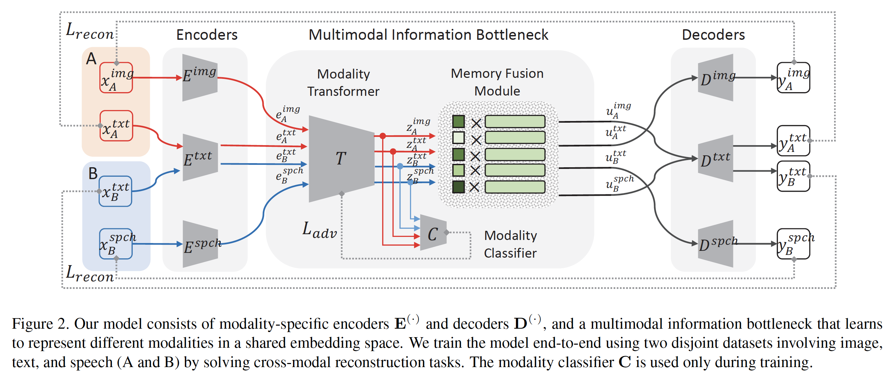
Multimodal Information Bottleneck
Multimodal Information Bottleneck
Ma S, McDuff D, Song Y. Unpaired Image-to-Speech Synthesis with Multimodal Information Bottleneck[C]//Proceedings of the IEEE International Conference on Computer Vision. 2019: 7598-7607.

Slide 11
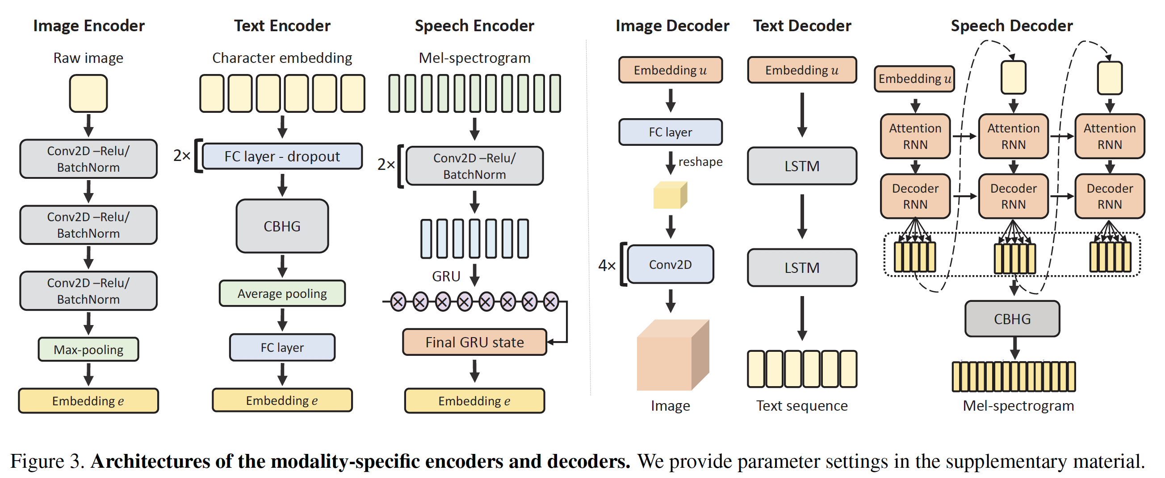
Multimodal Information Bottleneck
Modality Specific Encoders and Decoders
Ma S, McDuff D, Song Y. Unpaired Image-to-Speech Synthesis with Multimodal Information Bottleneck[C]//Proceedings of the IEEE International Conference on Computer Vision. 2019: 7598-7607.

Slide 12
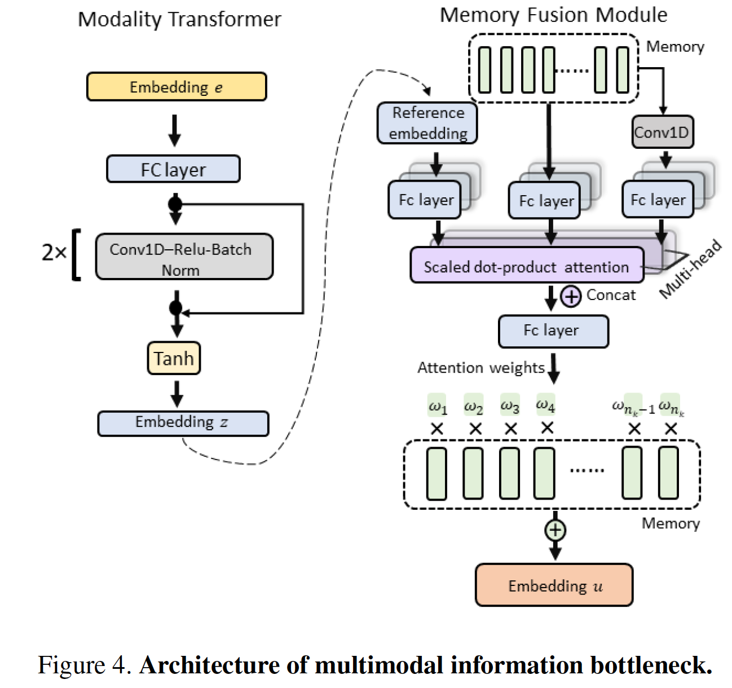
Multimodal Information Bottleneck
Multimodal Information Bottleneck
Ma S, McDuff D, Song Y. Unpaired Image-to-Speech Synthesis with Multimodal Information Bottleneck[C]//Proceedings of the IEEE International Conference on Computer Vision. 2019: 7598-7607.

Slide 13
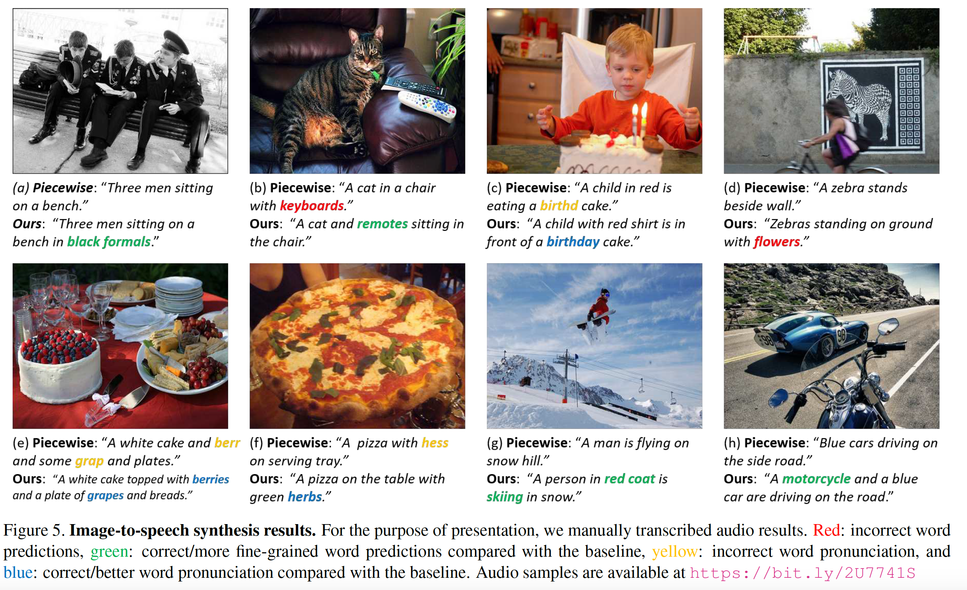
Experiments
Ma S, McDuff D, Song Y. Unpaired Image-to-Speech Synthesis with Multimodal Information Bottleneck[C]//Proceedings of the IEEE International Conference on Computer Vision. 2019: 7598-7607.

Slide 14
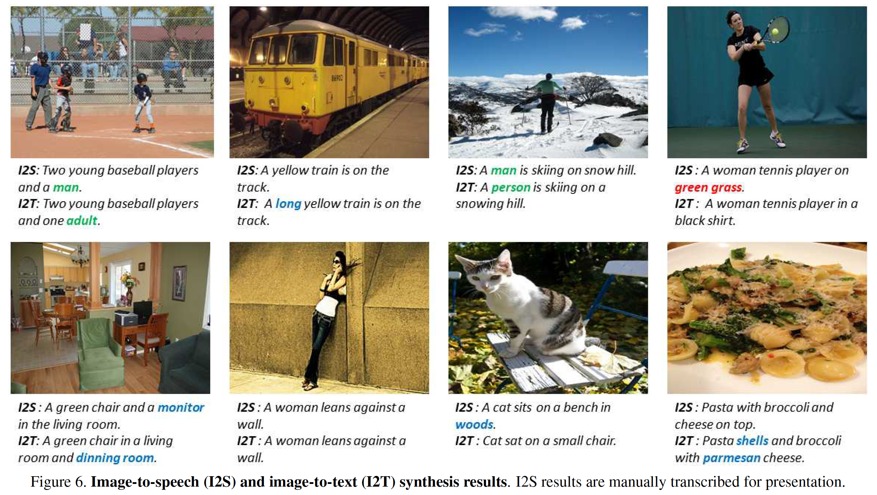
Experiments
Ma S, McDuff D, Song Y. Unpaired Image-to-Speech Synthesis with Multimodal Information Bottleneck[C]//Proceedings of the IEEE International Conference on Computer Vision. 2019: 7598-7607.

Slide 15
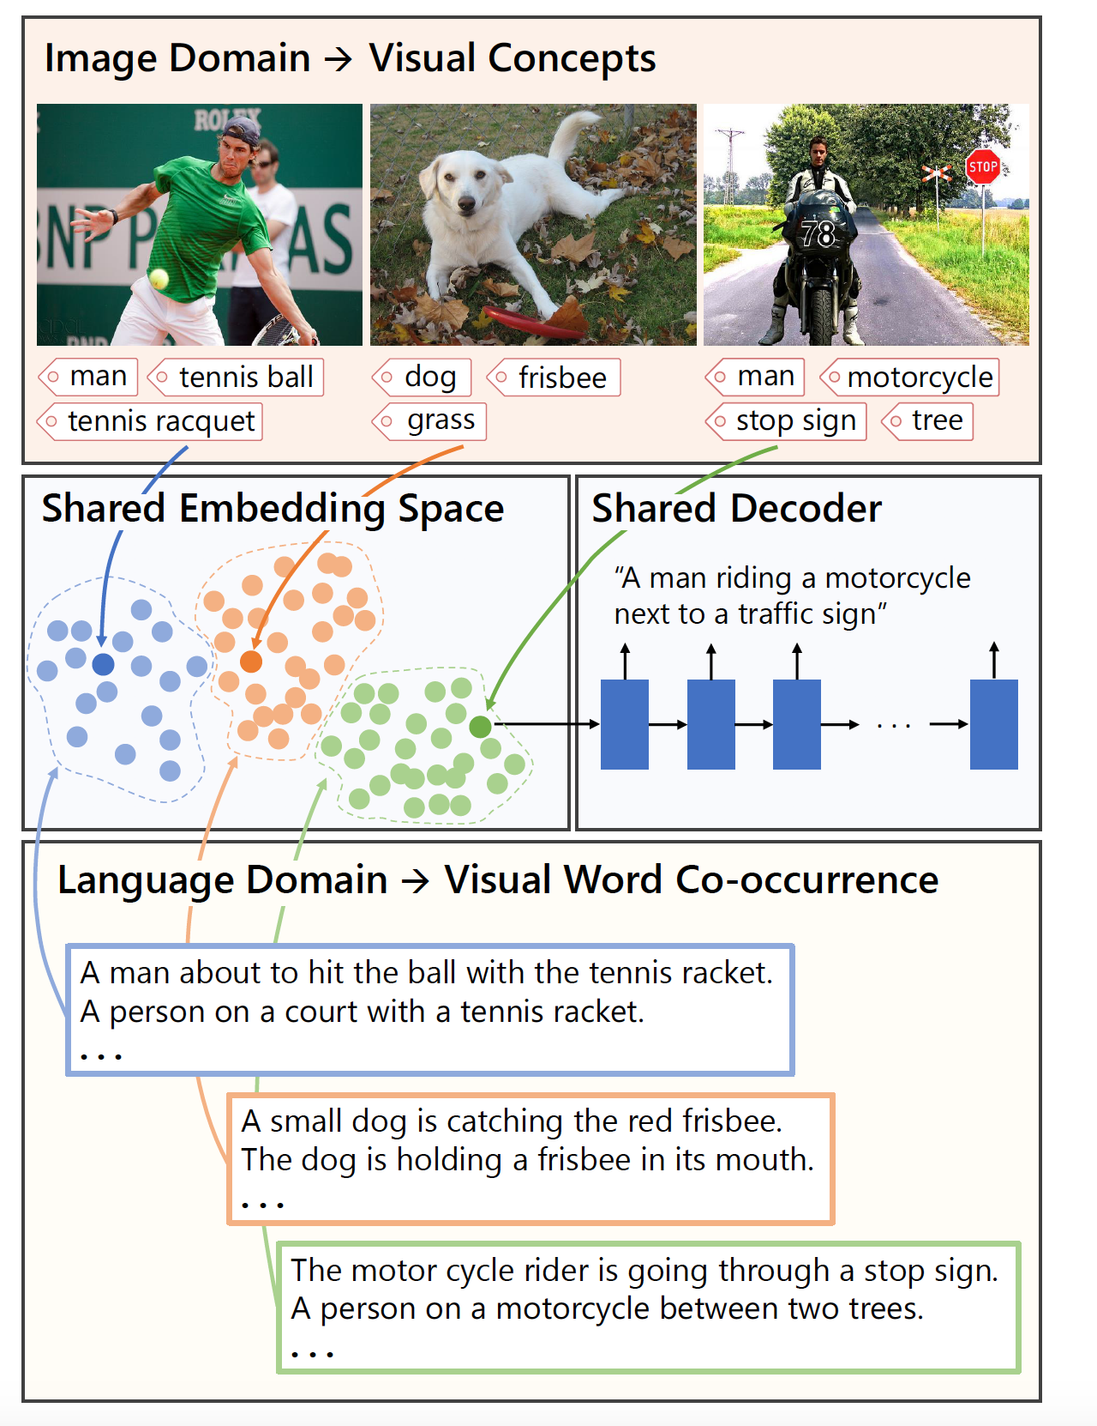
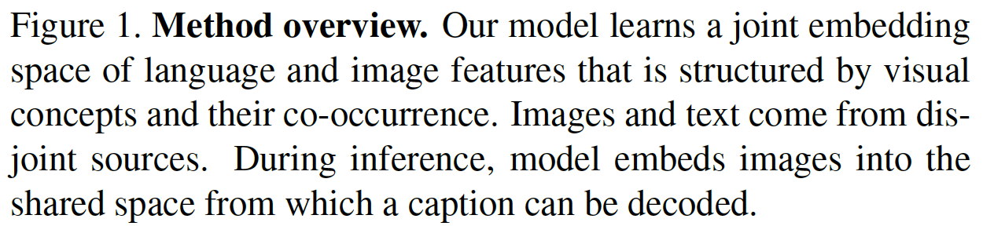
Unsupervised Image Captioning
In this paper, we address image captioning by generating language descriptions of scenes without learning from annotated pairs of images and their captions.
Laina I, Rupprecht C, Navab N. Towards Unsupervised Image Captioning with Shared Multimodal Embeddings[C]//Proceedings of the IEEE International Conference on Computer Vision. 2019: 7414-7424.

Slide 16
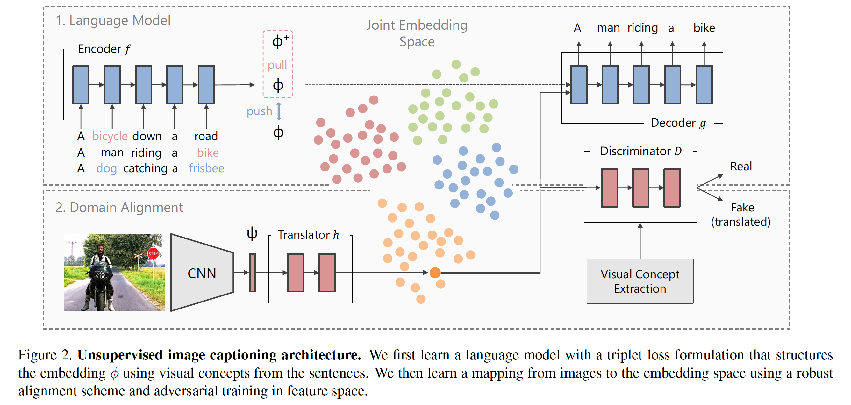
Unsupervised Image Captioning
Laina I, Rupprecht C, Navab N. Towards Unsupervised Image Captioning with Shared Multimodal Embeddings[C]//Proceedings of the IEEE International Conference on Computer Vision. 2019: 7414-7424.

Slide 17
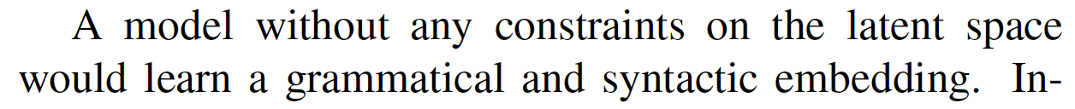
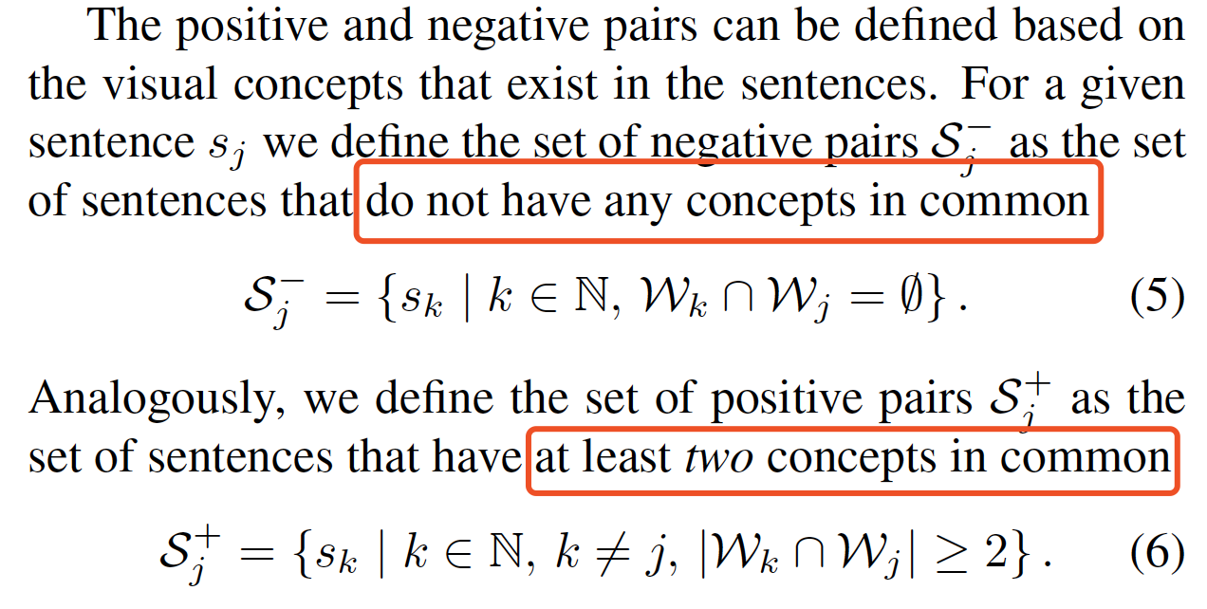
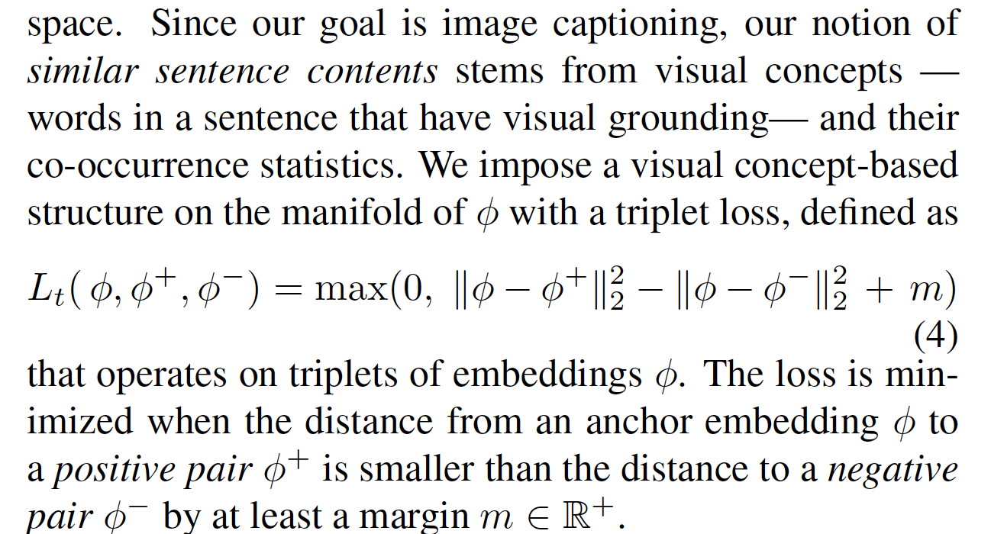
Unsupervised Image Captioning
Language Model
Laina I, Rupprecht C, Navab N. Towards Unsupervised Image Captioning with Shared Multimodal Embeddings[C]//Proceedings of the IEEE International Conference on Computer Vision. 2019: 7414-7424.

Slide 18
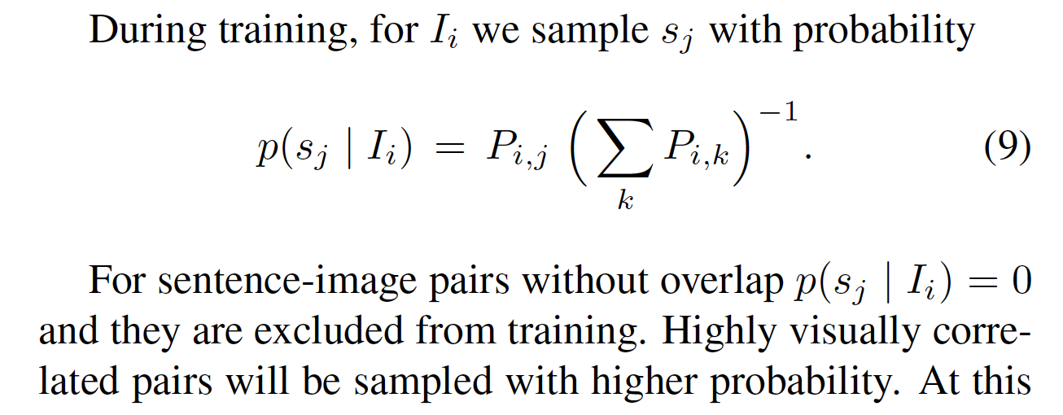
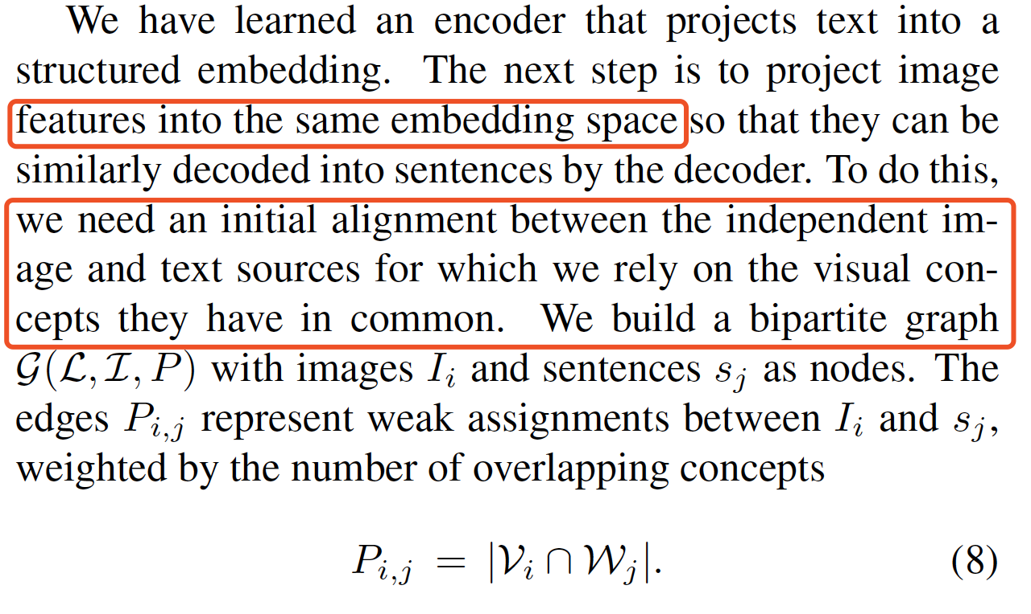
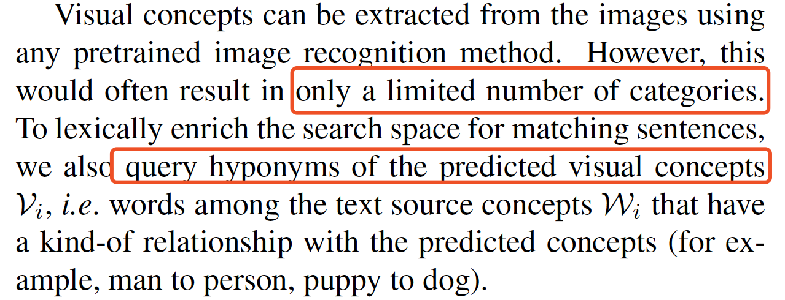
Unsupervised Image Captioning
Joint Image and Language Domain
Laina I, Rupprecht C, Navab N. Towards Unsupervised Image Captioning with Shared Multimodal Embeddings[C]//Proceedings of the IEEE International Conference on Computer Vision. 2019: 7414-7424.

Slide 19
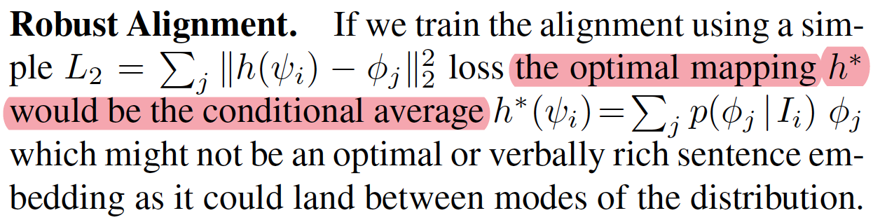
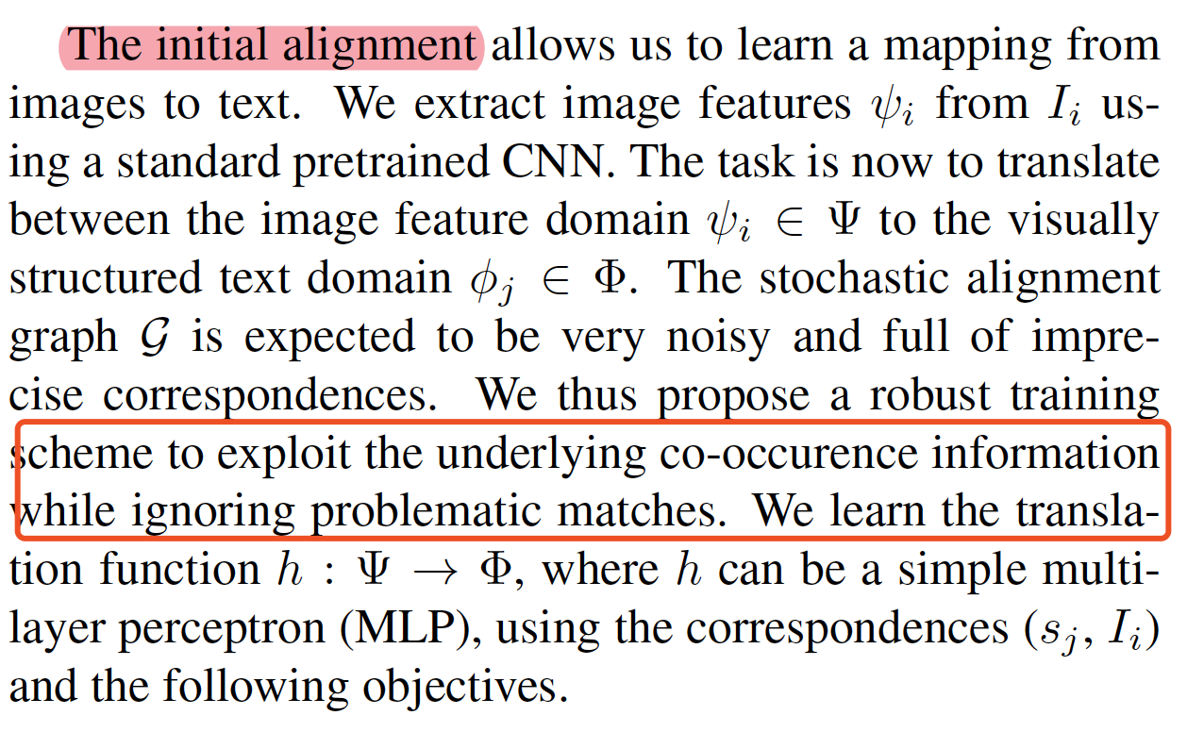
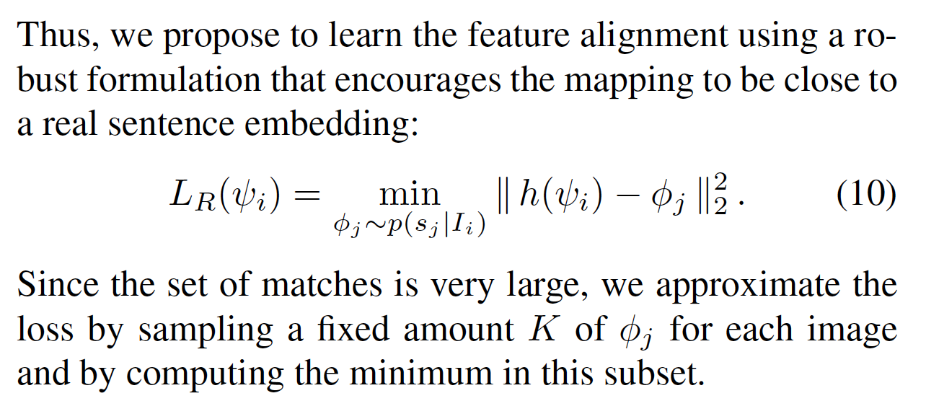
Unsupervised Image Captioning
Learning the Semantic Alignment
Laina I, Rupprecht C, Navab N. Towards Unsupervised Image Captioning with Shared Multimodal Embeddings[C]//Proceedings of the IEEE International Conference on Computer Vision. 2019: 7414-7424.

Slide 20
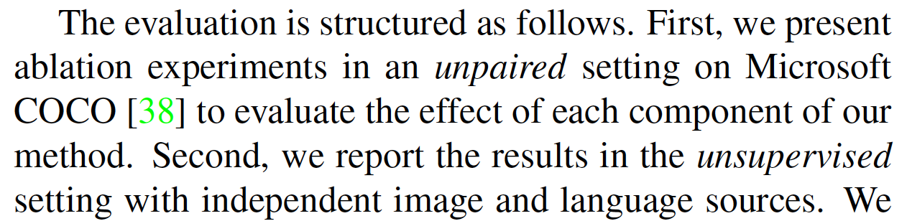
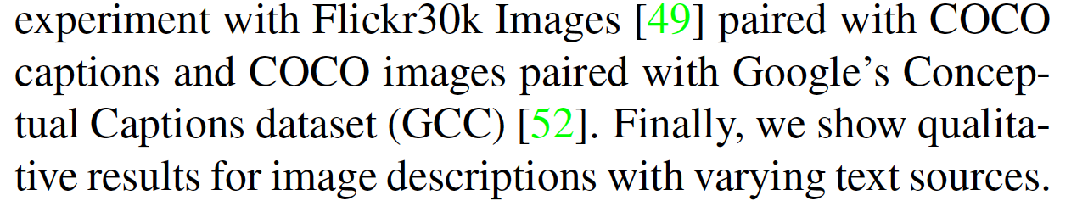
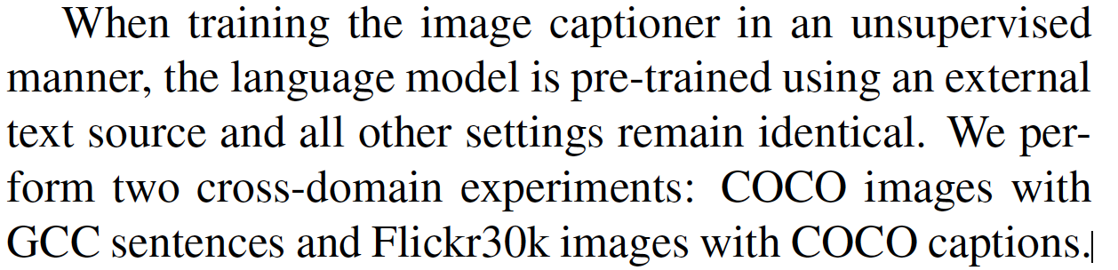
Experiments
Unpaired
Unsupervised
Laina I, Rupprecht C, Navab N. Towards Unsupervised Image Captioning with Shared Multimodal Embeddings[C]//Proceedings of the IEEE International Conference on Computer Vision. 2019: 7414-7424.

Slide 21
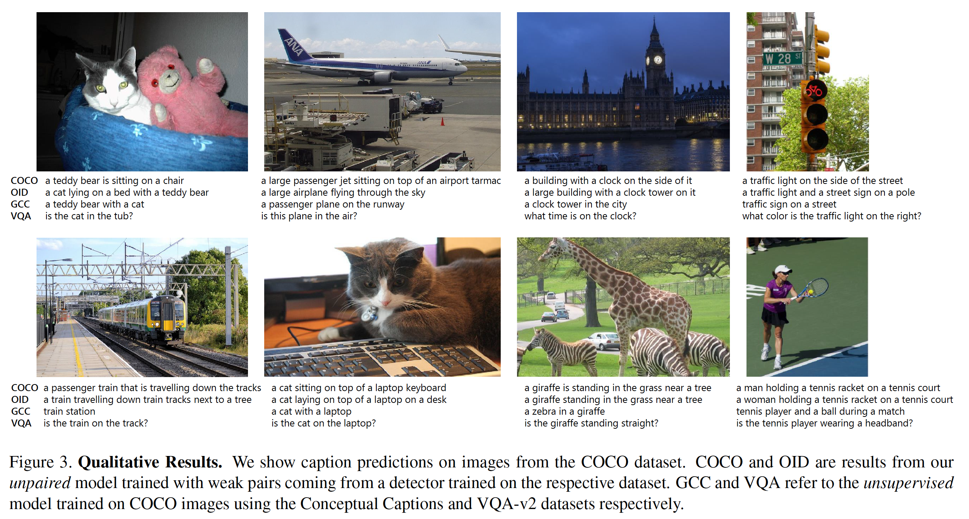
Unsupervised Image Captioning
Laina I, Rupprecht C, Navab N. Towards Unsupervised Image Captioning with Shared Multimodal Embeddings[C]//Proceedings of the IEEE International Conference on Computer Vision. 2019: 7414-7424.

Slide 22
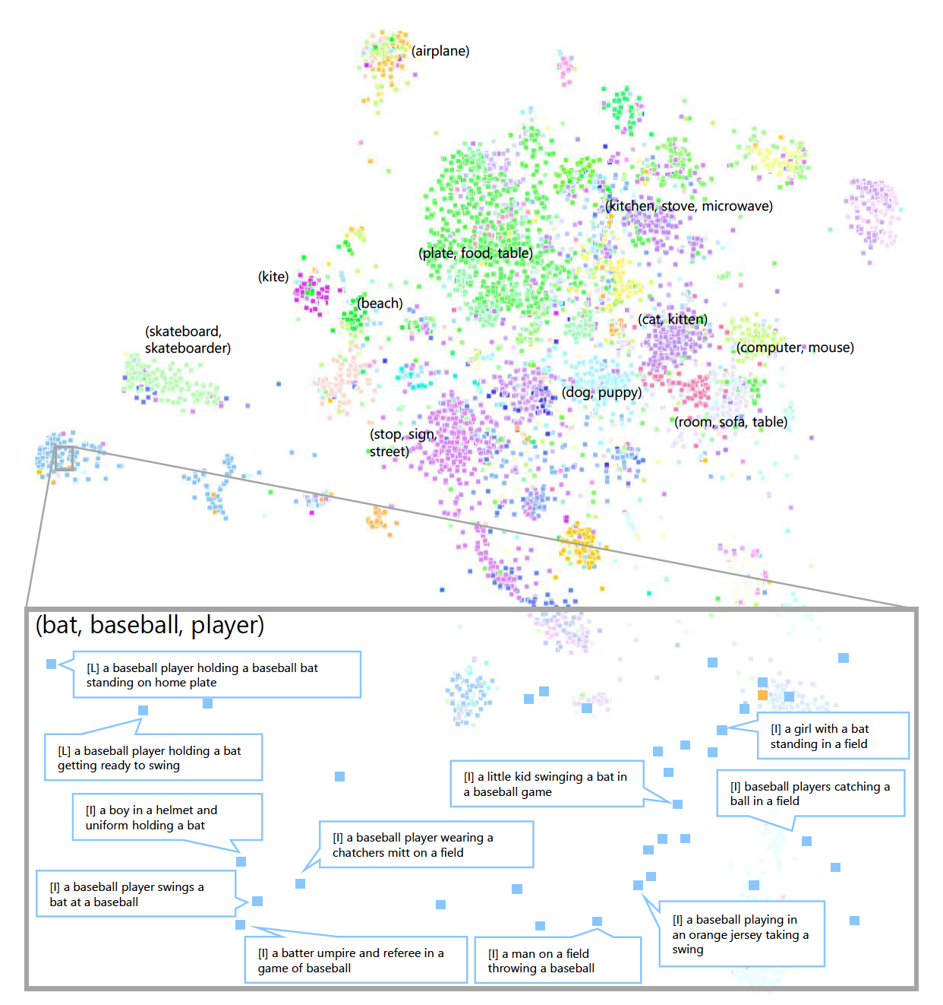
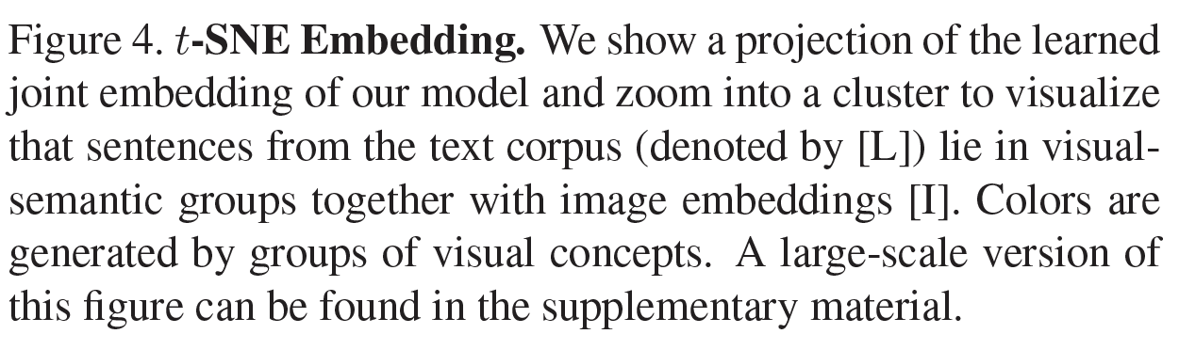
Experiments
Laina I, Rupprecht C, Navab N. Towards Unsupervised Image Captioning with Shared Multimodal Embeddings[C]//Proceedings of the IEEE International Conference on Computer Vision. 2019: 7414-7424.

